Slide 1

CHICAGO CITY CRIME
VISUALISATION
SUBMITEED BY
VARUN KAUSHIK(17BCE0182)
PULKIT GUPTA (17BCE0631)
SUBMITTED TO
Prof. ANNAPURNA JONNALAGADDA

Slide 2

Problem Statement:
The Crime in Chicago is increasing more and more, people care about their safety, and the government leader want to build a good environment for the citizens.
Therefore, it is required to predict the occurrence of a crime at a location at a specific time of a day and to anticipate if a particular person in the city, at any given duration of the day will be a crime hotspot or not, with an acceptable rate of accuracy.

Slide 3
Gaps identified
Currently there is no such analysis and visualisation of this dataset which covers each type of unitwise visualisation(like day,month,year etc.)
No visualisation exist which gives the exact location of the crime areas to analyse them easily.
Advanced graph like ggplot to show realtime location and time has not been covered till now on this dataset.

Slide 4
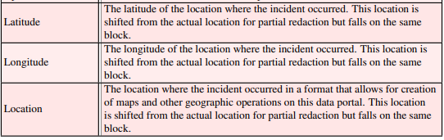
Proposed Algorithm
We are using the Classification algorithm in this project to accomplish our task.
First measure is dividing the entire city of Chicago into smaller units called cells, each district of Chicago is evaluated as a cell.
In the meta-data obtained from the CLEAR system of Chicago Police Department, each criminal record is characterized by several attributes that includes crime description, location, longitudes and latitudes etc.

Slide 5
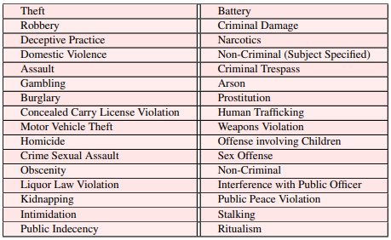
These attributes comprise the dataset of the system model adopted by our project and will be conducive while plotting the exact locations of the crimes.
In addition, the CLEAR system classifies the crimes into 32 different categories .
With all the attributes, we expect to depict the pattern of each crime-type across the City of Chicago

Slide 6
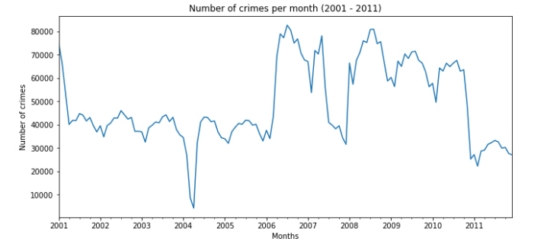
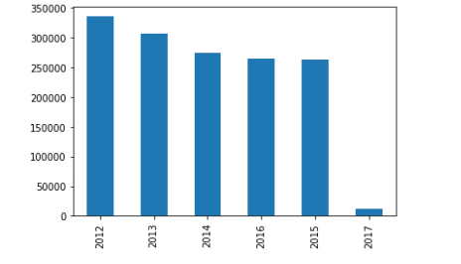
Result Analysis
we visualized the data using different ways. We analysed trend of crime occurrence for each year. Then, we plotted crime occurrence rates of the following: crime type, scene of crime, hour-day-month of crime. This gives us a better understanding of the major crimes that occur.

Slide 7
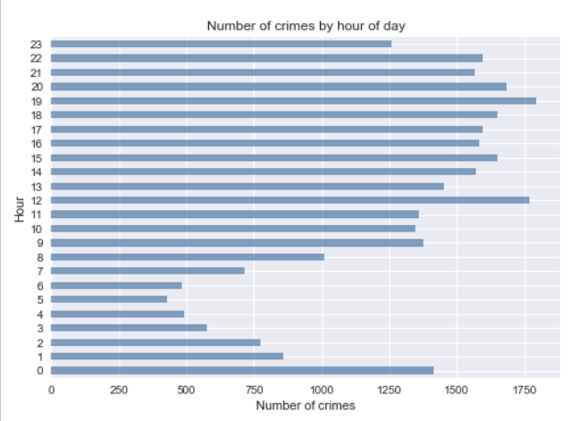
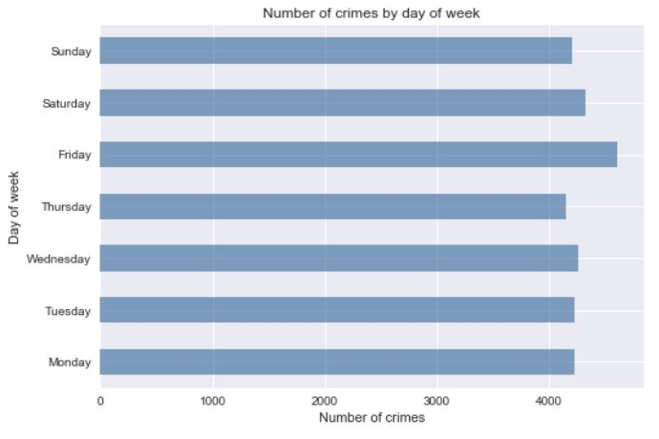
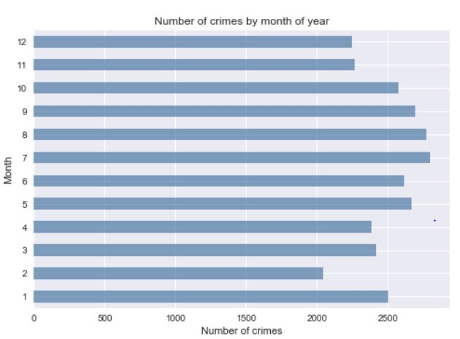

Slide 8
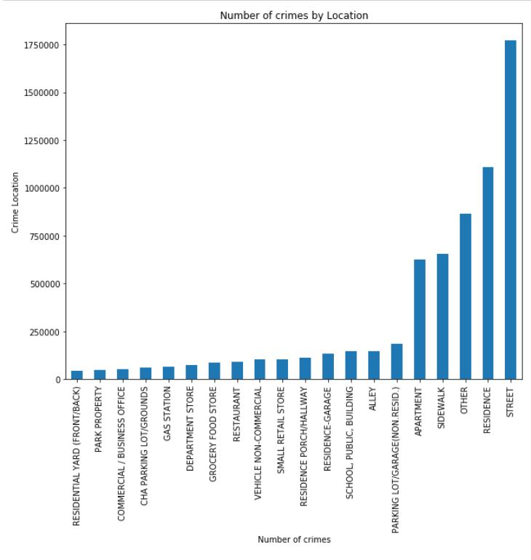
We identified locations that are more prone to crimes, street being the scene with highest crime rate. Also pointing out the exact location (latitude and longitude) of that place.

Slide 9
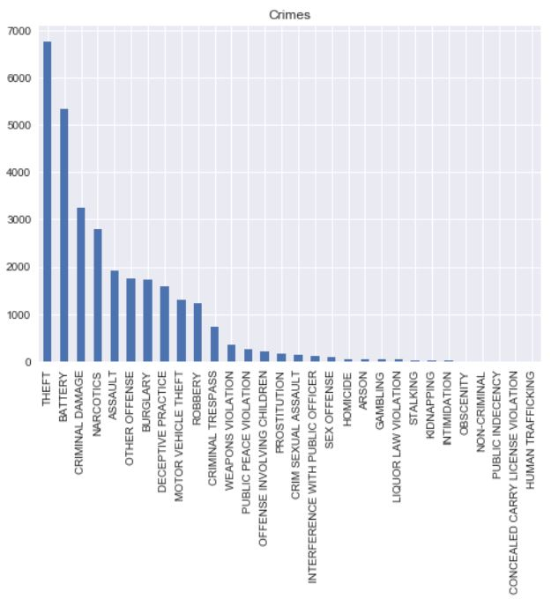
We interpret that theft has the highest percentage and is the crime type with the highest crime rate.

Slide 10
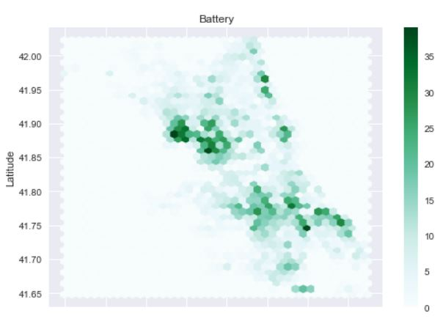
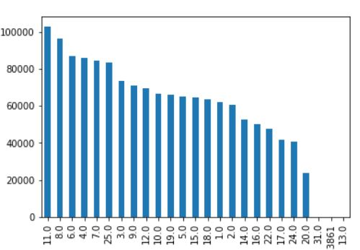
We visualise the most crime according to the districts , it is easy for department to coordinate and handle the crime
And also the exact location(latitude & longitude ) of the place where that particular crime occurred.

Slide 11
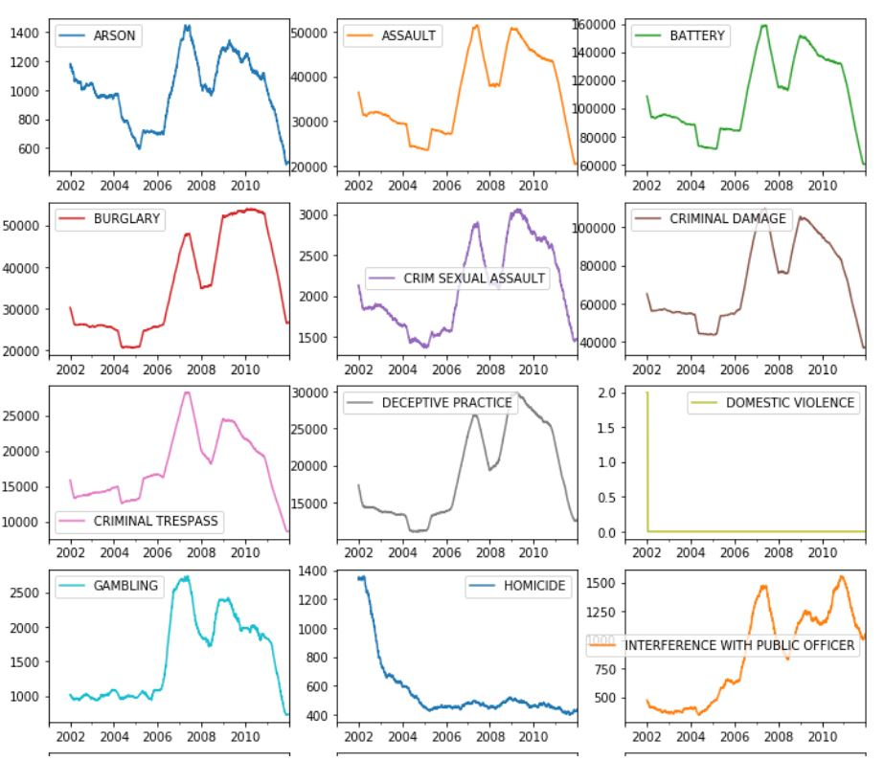

Slide 12
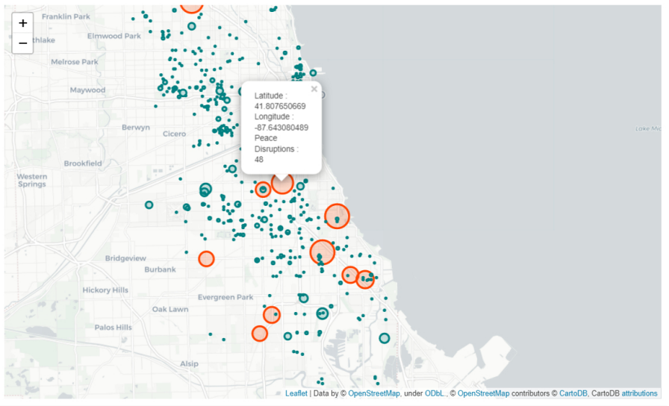
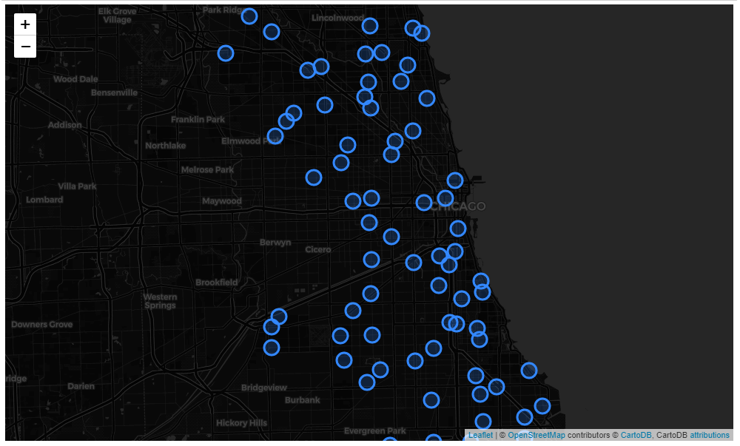
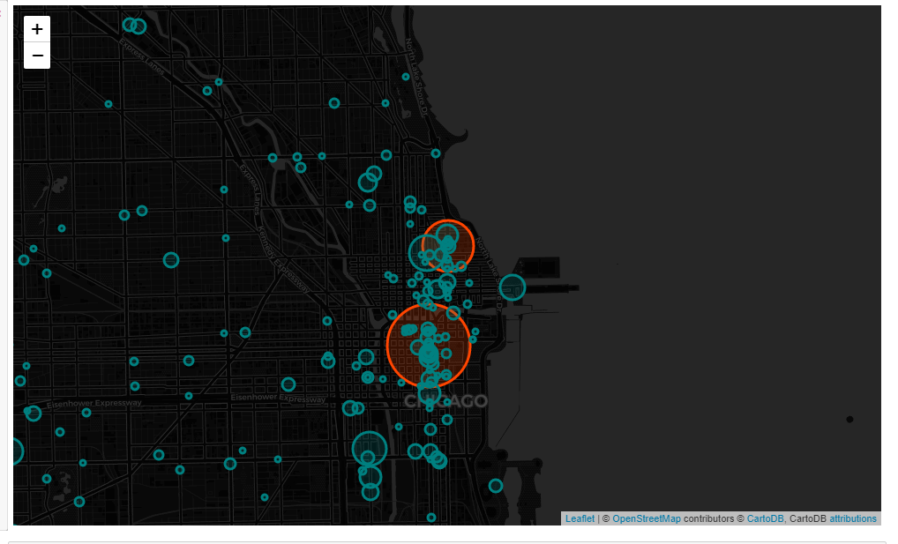

Slide 13
References
[1] Kassen, M. (2013). A promising phenomenon of open data: A case study of the Chicago open data project. Government Information Quarterly, 30(4), 508-513.
[2] Nakaya, T., & Yano, K. (2010). Visualising crime clusters in a space‐time cube: An exploratory data‐analysis approach using space‐time kernel density estimation and scan statistics. Transactions in GIS, 14(3), 223-239
[3] Ratcliffe, J. H. (2000, September). Visualising crime hotspots and making sense of high volume crime. In a paper presented to the Australian Institute of Criminology conference Crime Mapping: Adding Value to Crime Prevention, Adelaide.
[4] Shiode, S., Shiode, N., Block, R., & Block, C. R. (2015). Space-time characteristics of micro-scale crime occurrences: an application of a network-based space-time search window technique for crime incidents in Chicago. International Journal of Geographical Information Science, 29(5), 697-719.
[5] Aurisano, J., Kumar, A., Gonzales, A., Reda, K., Leigh, J., Di Eugenio, B., & Johnson, A. (2015). Show me data”: Observational study of a conversational interface in visual data exploration. In IEEE VIS (Vol. 15, p. 1).

Slide 14
[6] Goldschneider, M. (2010). GEOGRAPHY OF CRIME. REMARKS ON SPATIAL ANALYSES OF CRIME WITH THE USE OF DIGITAL TECHNOLOGIES. Archiwum Kryminologii, (32), 23-44.
[7] Rossy, Q., & Ribaux, O. (2014). A collaborative approach for incorporating forensic case data into crime investigation using criminal intelligence analysis and visualisation. Science & Justice, 54(2), 146-153.
[8] Brunsdon, C., Corcoran, J., & Higgs, G. (2007). Visualising space and time in crime patterns: A comparison of methods. Computers, environment and urban systems, 31(1), 52-75.
[9] Gottschalk, P., & Tolloczko, P. C. (2007). Maturity model for mapping crime in law enforcement. Electronic Government, An International Journal, 4(1), 59-67.
[10] Ratcliffe, J. H., & McCullagh, M. J. (1999). Hotbeds of crime and the search for spatial accuracy. Journal of geographical systems, 1(4), 385-398.
[11] Rauscher, J., Swiezinski, L., Riedl, M., & Biemann, C. (2013, June). Exploring cities in crime: significant concordance and co-occurrence in quantitative literary analysis. In Proceedings of the Workshop on Computational Linguistics for Literature (pp. 61-71).

Slide 15
[12] Bonatsos, A., Middleton, L., Melas, P., & Sabeur, Z. (2013, October). Crime open data aggregation and management for the design of safer spaces in urban environments. In International Symposium on Environmental Software Systems (pp. 311-320). Springer, Berlin, Heidelberg.
[13] Vasiliauskas, D., & Beconytė, G. (2016). Cartography of crime: Portrait of metropolitan Vilnius. Journal of Maps, 12(5), 1236-1241.
[14] Brunsdon, C., & Corcoran, J. (2006). Using circular statistics to analyse time patterns in crime incidence. Computers, Environment and Urban Systems, 30(3), 300-319.
[15] Oatley, G. C., & Ewart, B. W. (2003). Crimes analysis software:‘pins in maps’, clustering and Bayes net prediction. Expert Systems with Applications, 25(4), 569-588.
[16] Sathyadevan, S., & Gangadharan, S. (2014, August). Crime analysis and prediction using data mining. In 2014 First International Conference on Networks & Soft Computing (ICNSC2014) (pp. 406-412). IEEE.
[17] Ratcliffe, J. H. (2002). Aoristic signatures and the spatio-temporal analysis of high volume crime patterns. Journal of quantitative criminology, 18(1), 23-43.

Slide 16
[18] Corcoran, J., Wilson, I. D., Lewis, O. M., & Ware, J. A. (2001, October). Data clustering and rule abduction to facilitate crime hot spot prediction. In International Conference on Computational Intelligence (pp. 807-821). Springer, Berlin, Heidelberg.
[19] Adderley, R. W., & Musgrove, P. (2001). Police crime recording and investigation systems–A user’s view. Policing: An International Journal of Police Strategies & Management, 24(1), 100-114.
[20] Kang, H. W., & Kang, H. B. (2017). Prediction of crime occurrence from multi-modal data using deep learning. PloS one, 12(4), e0176244.

Slide 17
Thank you

